Slide 1
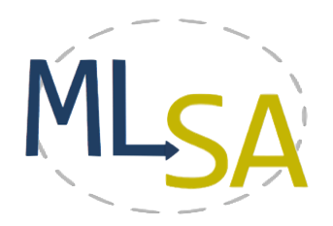
Lightweight Multilingual Software Analysis
Damian M. Lyons¹, Anne Marie Bogar¹ and David Baird²
¹Department of Computer & Information Science, Fordham University, New York NY USA
²Bloomberg L.P., New York NY USA
{dlyons,abogar}@fordham.edu, dbaird16@bloomberg.net
The authors acknowledge the contributions of Bruno Vieira, Sunand Raghupathi and Nicholas Estelami in building MLSA Tools
The authors are partially supported by grant DL-47359-15016 from Bloomberg L.P.

Slide 2
Motivation
Companies with a large software base:
have to manage software architectures and libraries that
Are written by different developers (in & out house)
Are developed over many decades
Are often in different languages
In order to enforce
Security
Efficiency
Quality Metrics

Slide 3
Why is Multilingual Software a Problem?
A multilingual codebase gives rise to many software engineering issues, including
Redundancy, e.g., procedures in several different language libraries for the same functionality, necessitating refactoring
Debugging complexity as languages interact with each other in unexpected ways
Security issues relating to what information is exposed when one language procedure is called from another
Problem of opacity when one language calls another

Slide 4
Approaches to the problem
Development tools tend to be language specific, with some cross-platform functionality. (e.g., Checkmarx offers static analysis)
One approach is to instead use a versatile monolingual environment
‘Reverse engineering’ approach: leverage a metalanguage, e.g., Rascal
Proposed Approach: Multilingual will always be with us. Develop lightweight tools to process multilingual codebase into unified common representations such as callgraphs, flowgraphs, etc.

Slide 5
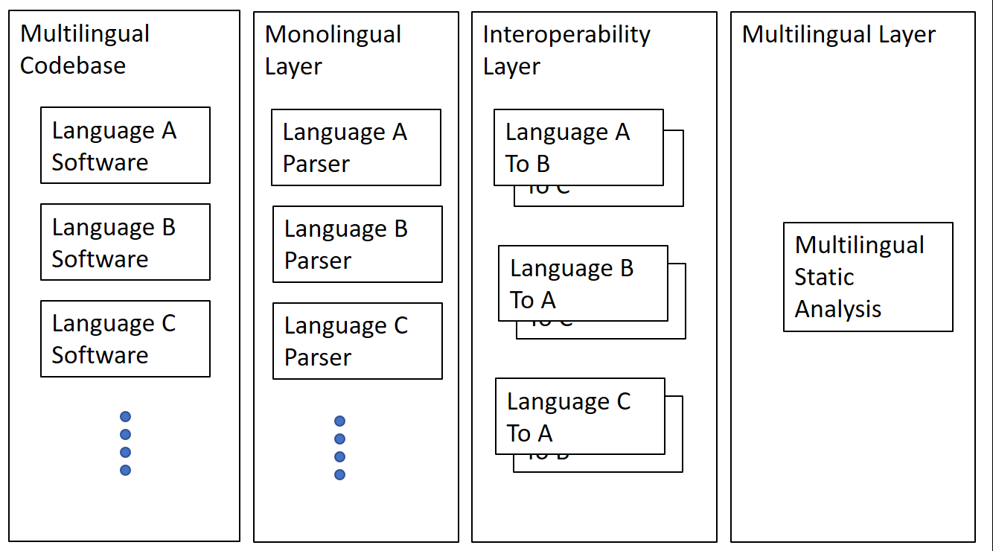
MultiLingual Static Analysis (MLSA) Architecture
Data flows left to right

Slide 6
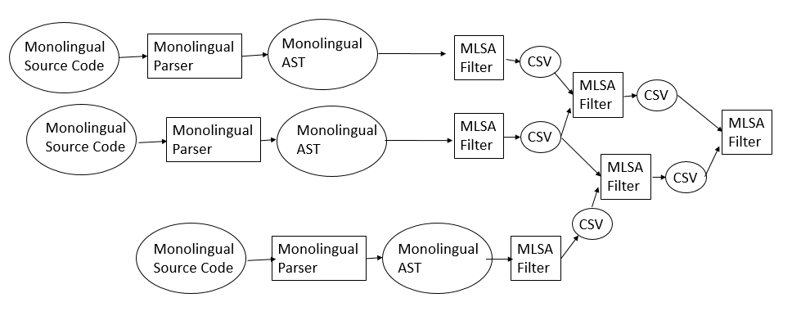
Example
All intermediate data store in the form of CSV “table” files

Slide 7
MLSA Architecture
Modularity:
Adding extra languages just requires adding new monolingual filters for the language.
Modifying analyses just requires reconfiguration of the analysis pipeline.
New analysis filters can build on existing filters (and their tabular CSV output)
Computational efficiency:
The policy of the pipelines was chosen to make parallelism and dependency explicit to allow for mapping to a cluster/cloud.

Slide 8
Call Graphs
Call graph analysis (CGA) is a useful software engineering tool
In particular, for multilingual code, the call graph can be used to investigate the boundary line between languages, a boundary that is opaque in many tools.
Example: a C program PC may call a Python PP procedure in addition to many C procedures.
All of PC’s calls are reviewed and safe.
However PP may opaquely call procedures from PC; these may or may not be safe.

Slide 9
Interoperability API
How calls from one language are made from another
Consider the C/Python boundary API (Python.h). Python code can be called from C non-interactively in the following ways (each of which have several variants and may require setup code):
PyRun_SimpleString(pyCodeString)
PyRun_SimpleFile(filePtr, fileName)
PyObject_CallObject(pFunc,pArgs)

Slide 10
Terminology
Program S_{c} is a set of (ℓ,b) basic block b with line number ℓ.
The set B of elementary statements includes a procedure call statement, and for (ℓ,b), b∈B procedure call, we define:
target(b): name of the called procedure
arg(b)=a₀,…,a_{n}: arguments of the call
RDA(p,X, ℓ) = {(x, ℓ’)|x∈X} is the line number ℓ’ of the last assignment in procedure p for each variable x.

Slide 11
The PyRun_SimpleFile API call
If (ℓ,b), b∈B, target(b)=PyRun_SimpleFile
For (x,ℓ’)∈RDA(p,{a₀},ℓ), with arg(b)=a₀,…,a_{n}
Calculate y=Eval(x, ℓ’), and if y≠∅,
Add (y,∅) to V_{C} and ((p,α),(y,∅)) to E_{C}

Slide 12
The PyObject_CallObject API
If (ℓ,b), b∈B, target(b)=PyObject_CallObject
For (x_{i},ℓ’)∈RDA(p,{a₀},ℓ), with arg(b)=a_{i} i=0..n
Calculate y_{i}=Eval(x_{i}, ℓ’), and if all y_{i}≠∅,
Add (y₀,y₁,…,y_{n}) to V_{C} , ((p,α),(y₀,y₁,…,y_{n})) to E_{C}

Slide 13
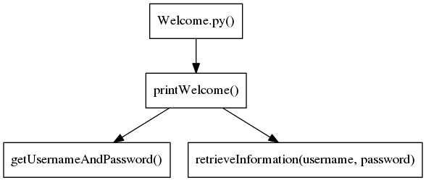
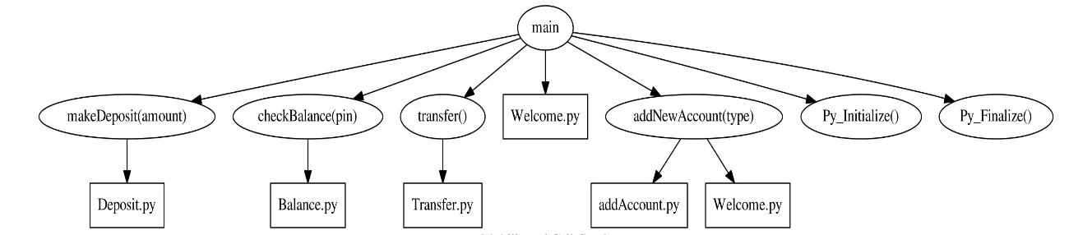
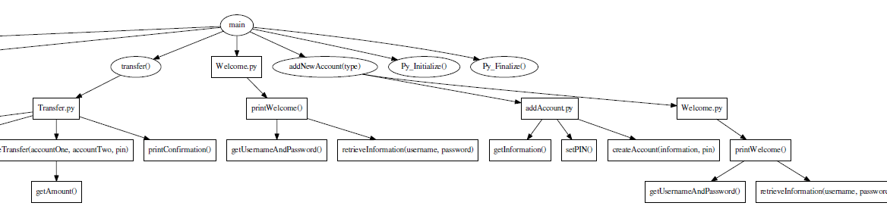
Example
Python library
C Codebase calling python
Multilingual Call Graph

Slide 14
Status
Filter modules
Call Graph Generators for C/C++, Python, and JavaScript Status: Non OO calls only, but OO calls statically identified
Interoperability filters: PyViaC/C++, PyViaJs, JsViaPy Status: One or two API calls implemented for each; none complete.
Flow Graph Generators for C/C++ Status: Partial implementation.
Assignment Collector/Static Evaluator for C Status: Only evaluates literal assignments
Reaching Definitions Module Status: Tested on C but is language independent

Slide 15
Collaboration
MLSA is open-source and freely available at
TWIKI – https://goo.gl/6mvyNS
GitHUB – https://git.io/MLSA
Email – multilingualsa@gmail.com
We are actively seeking open source collaborators and participants
There are videos available at https://goo.gl/g8ra15 showing
How to download and install MLSA
How to test on the test folders provided
How to add to MLSA

Slide 16
Conclusion & Future Work
We propose an architecture comprised of monolingual filter programs that analyse single language AST and identify the cross-language boundary. The filters generate language independent information in CSV format. Additional multilingual filters operate on the CSV files in pipelines. This architecture has advantages of modularity and efficiency and is open-source friendly.
Future work includes
extension of the RDA analysis for more complex interoperability APIs, including use of DATALOG for analysis.
More extensive testing and comparisons of the CGs generated with those for existing CG tools

